Slide 1


CONFERENCE
„From a growing to a great city”
Craetive class – talent managment in cities
Rostock, 14 – 17 May 2017
smallships.eu

Slide 2
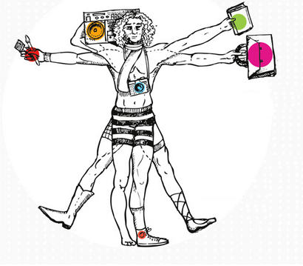
Super-creative core: It includes a wide range of occupations (e.g. science, engineering, education, computer programming, research), with arts, design, and media workers forming a small subset. Those belonging to group are "fully engage in the creative process". The Super-Creative Core is considered innovative, creating commercial products and consumer goods. The primary job function of its members is to be creative and innovative. "Along with problem solving, their work may entail problem finding„.
Creative professionals: These professionals are the classic knowledge-based workers and include those working in healthcare, business and finance, the legal sector, and education. They "draw on complex bodies of knowledge to solve specific problems" using higher degrees of education to do so (Florida, 2002).
In addition to these two main groups of creative people, the usually much smaller group of Bohemians is also included in the creative class.

Slide 3
To create creative cities 3 main factors are needed:
Talent
Tolerance
Technology

Slide 4
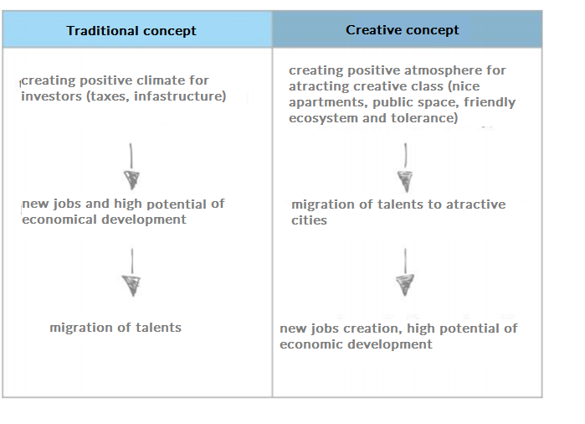
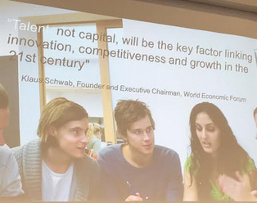
Traditional and creative concept of urban and regional development

Slide 5
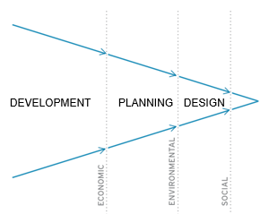
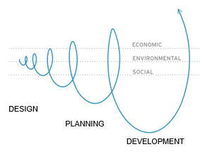
From a growing to a great city
„There is no longer a single city model but cities do have common features and face common challenges. Cities compete on the same scarce resources, talens and creative class.
The Systemic Thinking and multistakeholder’s approach is needed to create city’s value”
- Michel Sudarskis (Secretary General INTA – International Urban Development Association)

Slide 6
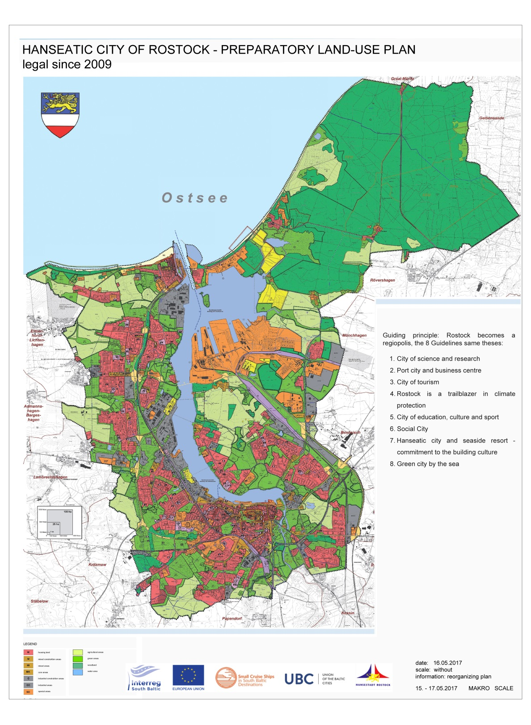
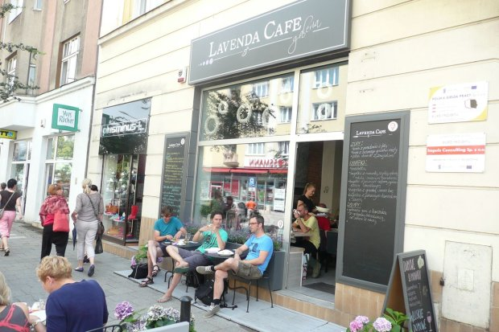
Act small
– make the inner city, the harbour area and Rostock in general more attractive for youth and families – normal income groups;
– expand the university and business cooperation;
– involve the citizens/ users in making the change;

Slide 7
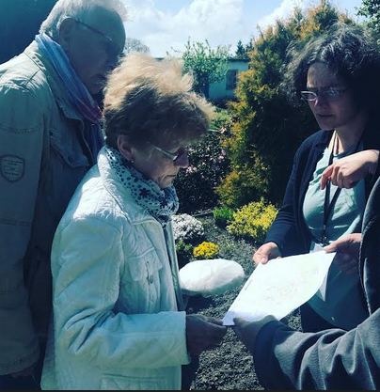
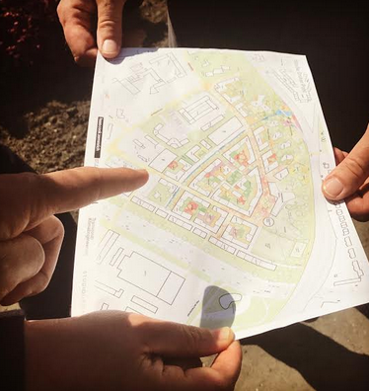
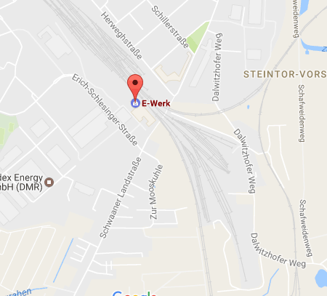

Involve people in cocreation process.

Slide 8
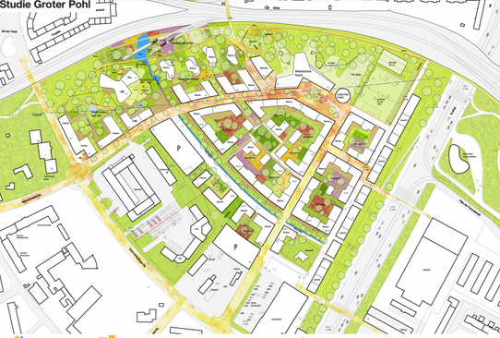
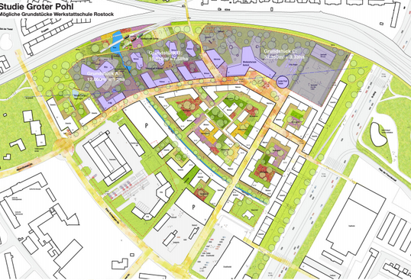
Make plans, stay positive. High potential milieu development in medium sized European city Rostock: job creation, upturn of local economy with impact to comprehensive urban develop-ment; caused by settlement of pioneers of new work- and lifestyles

Slide 9
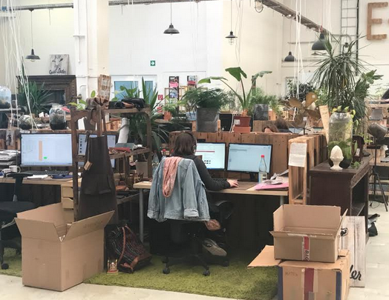
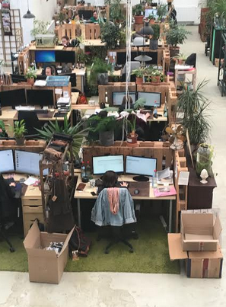
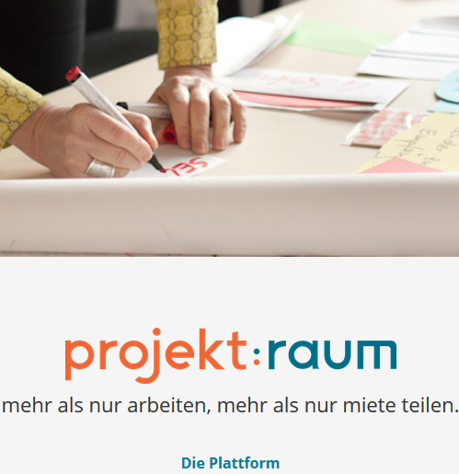
Open and friendly working spaces, close to the apartments

Slide 10
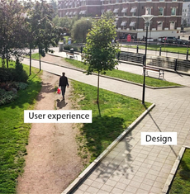
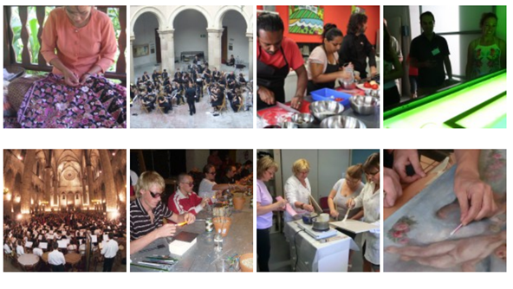
Involve people and make them engage and responsible
Let them experience and spend time together

Slide 11
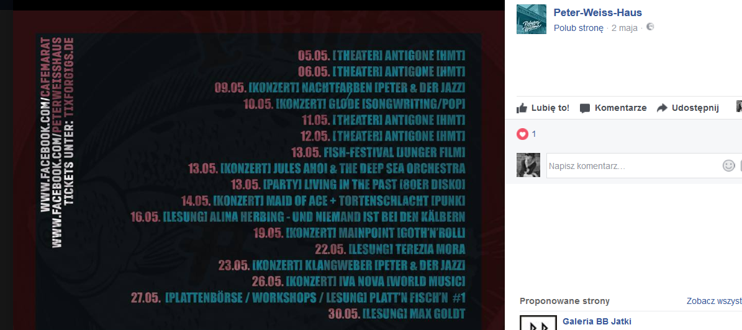
Atractive places to spend time after work like:
1. Peter – Weiss haus
Sport places, green areas, theatres, cinemas…

Slide 12
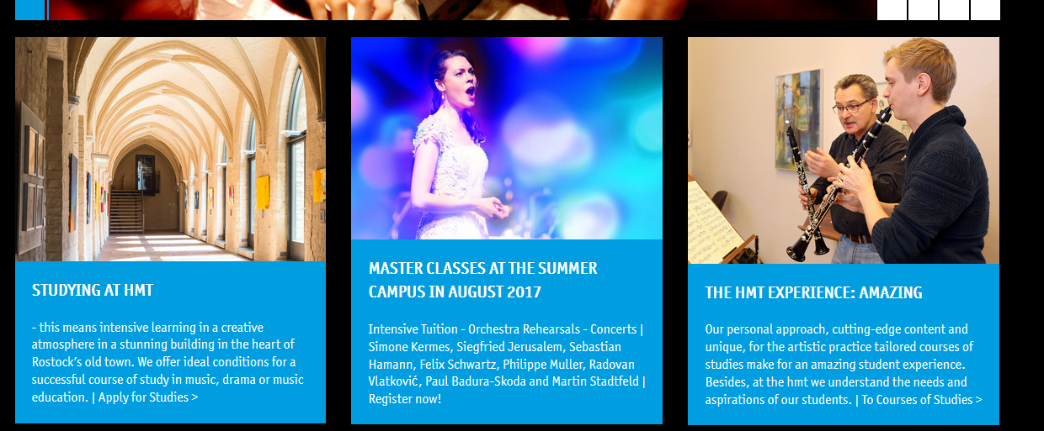
City needs excellent education on every level

Slide 13
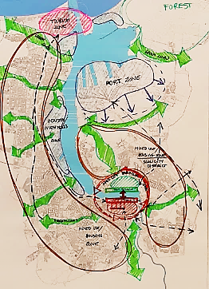
To make city friendly and atractive:
Architectural „Icon” building for Rostock;
Save urban structure of Rostock (green belts);
Make Rostock attractive for the whole year (especially a beating heart of Inner City waterfront) -
Promote Rostock as „Cluster Life City”
(perfect for Life, Work and Leisure);
Create new waterfront at the Eastern side and rebuild the Western side. Keep them public & open.

Slide 14
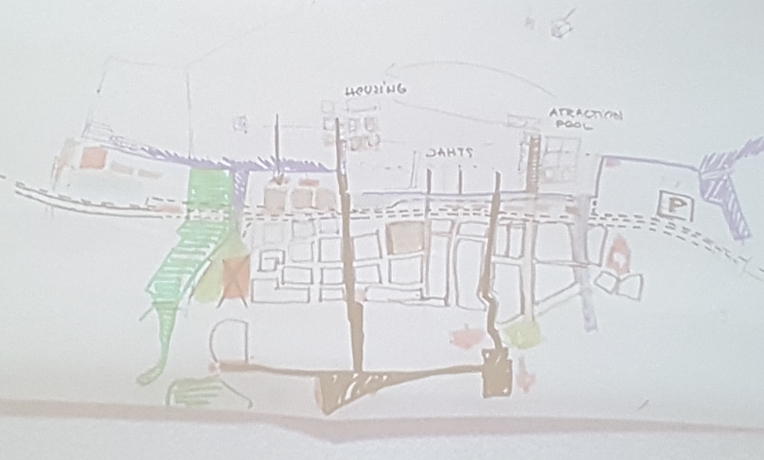
Make river & port present in the perception of citizens;
Create public & open spaces in waterfront – attractive and iconic landscape.

Slide 15
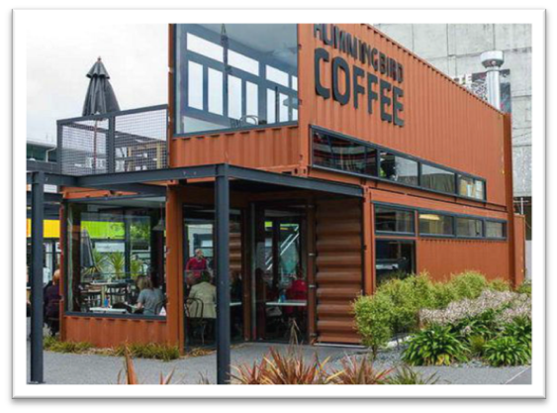
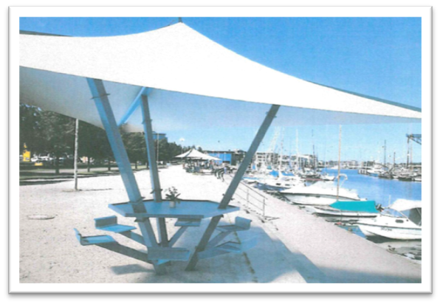
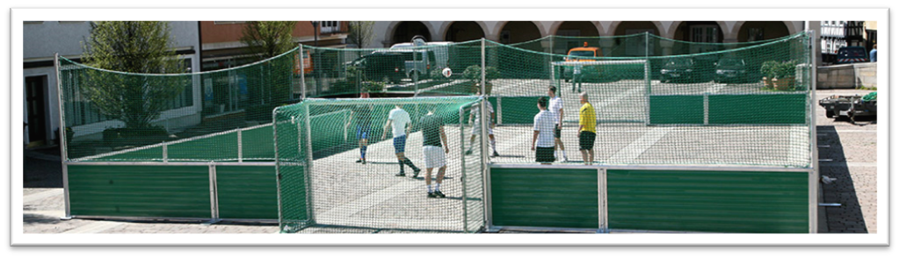
some suggested measures for short-term revitalization of city harbour
example for container modules for temporary uses in the area “Christinenhafen”
establishment of resting places
temporary sport field (e.g. for Beachvolleyball, Streetball or Streetsoccer)

